Slide 1



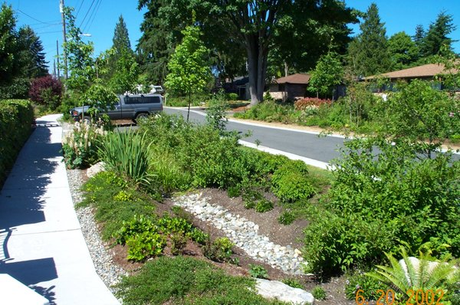

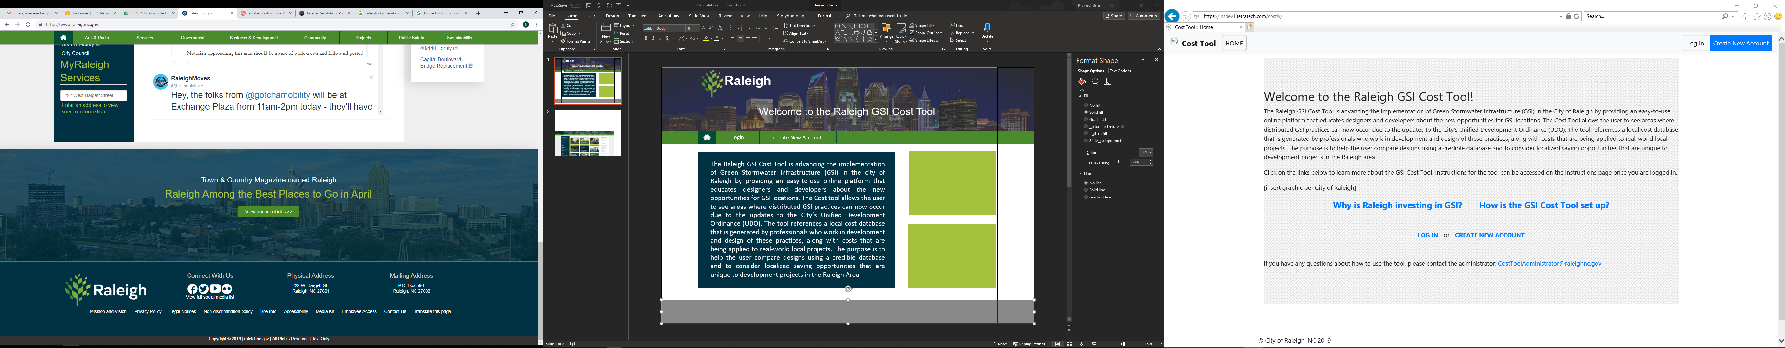
Raleigh
Welcome to the Raleigh GSI Cost Tool
Login
Create New Account
Hot to Set Up the GSI Cost Tool
Why is Raleigh investing in GSI
Instructions
What is the GSI Cost Tool?
The Raleigh GSI Cost Tool is advancing the implementation of Green Stormwater Infrastructure (GSI) in the city of Raleigh by providing an easy-to-use online platform that educates designers and developers about the new opportunities for GSI locations.
The Cost tool allows the user to see areas where distributed GSI practices can now occur due to the updates to the City’s Unified Development Ordinance (UDO). The tool references a local cost database that is generated by professionals who work in development and design of these practices, along with costs that are being applied to real-world local projects. The purpose is to help the user compare designs using a credible database and to consider localized saving opportunities that are unique to development projects in the Raleigh Area.
Why is Raleigh investing in GSI >
How is the GSI Cost Tool set up >
If you have any questions about how to use the tool, please contact the administrator: CostToolAdministrator@raleighnc.gov

Slide 2
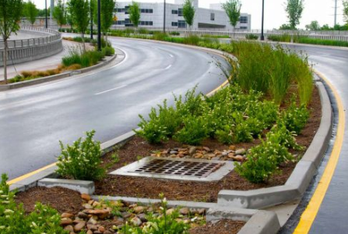
Raleigh
Welcome to the Raleigh GSI Cost Tool
Login
Create New Account
Hot to Set Up the GSI Cost Tool
Why is Raleigh investing in GSI
Instructions
Why Raleigh is investing in GSI
The Raleigh GSI Cost Tool is part of the City’s greater initiative to implement more Green Stormwater Infrastructure (GSI) throughout new and existing development sites. The City has a goal to incorporate a greater number of distributed practices on site to maximize stormwater capture. The standard design that development sites use for stormwater management is designating a large portion of land adjacent to the site for the installation of an end-of-pipe conventional structure, such as a stormwater wetland or detention pond. The City wants to show developers and designers that a site can use a more creative solution that can be more cost effective compared to the conventional solutions. Using distributed practices to better manage stormwater runoff helps minimize the amount of excess land needed to meet the three main levels of compliance:
Nutrient management with or without buy down
Stormwater volume requirements
Peak flow capture
The City is also interested in GSI because of the additional social and environmental benefits that it can provide. Several tools have been created to view the triple bottom line (i.e., economic, social and environmental) benefits that alternative designs like GSI provide a community.

Slide 3

Raleigh
Welcome to the Raleigh GSI Cost Tool
Login
Create New Account
Hot to Set Up the GSI Cost Tool
Why is Raleigh investing in GSI
Instructions
How the GSI Cost Tool is set up
The Raleigh GSI Cost Tool is set up to help developers and designers with two functions: 1) learning more about GSI options under the changes in the City of Raleigh’s Unified Development Ordinance (UDO), and 2) comparing cost implications of various conventional and GSI design scenarios.
The first function is for those wishing to access the tool’s educational component. In the Opportunity Screening, the user is exposed to educational materials about changes in the City’s UDO and new opportunities for locations that designers can implement distributed green stormwater infrastructure practices. The user is also given information about the
compliance standards set for development, and the potential savings for implementing GSI. The Opportunity Screening guides the user with information that is needed to complete Scenarios within the Cost Analysis.
The second function of the tool allows the users to evaluate the specific costs of interest for design Scenarios entered into the tool. The user will need to define characteristics of the Project and can create one or multiple Scenarios to conduct a life cycle cost evaluation. Users are able to change default assumptions within the tool, import individual costs for specific cost items, and compare Scenarios within each Project site. A summary of these overall costs and differences between Scenarios can be viewed, exported and printed by the user.

Slide 4

Raleigh
Welcome to the Raleigh GSI Cost Tool
Login
Create New Account
Hot to Set Up the GSI Cost Tool
Why is Raleigh investing in GSI
Instructions
Instructions for using the Raleigh Cost Tool
Setting up a new project
To begin a project site assessment using the Raleigh Cost Tool, navigate to the PROJECTS tab from the menubar and click on the NEW PROJECT BUTTON. When you create a new project, specify a title, project description, the location and size of the project, and purchase information. Projects can be exported into .csv, excel, PDF, or printed. The summary table of your project displayed on the PROJECT PAGE can also be copied and pasted into a word document file or spreadsheet.
Designing scenarios for your project
After creating a project, click the SCENARIOS BUTTON to view and existing scenarios or create a new one. Click the NEW SCENARIO BUTTON to create a new scenario, where you will be directed to a new page to begin adding information about your scenario. You can click to go
back to the main SCENARIO PAGE at any point to delete, edit, copy, or export your scenario. When a scenario is selected, the DUPLICATE SCENARIO BUTTON will be displayed. When clicked, select yes on the prompt if you want to create a copy of your scenario.
When editing or creating a new scenario, the main COST TOOL PAGE will display six new tabs: (1) Project-Scenario Description, (2) Non-Conventional Structure, (3) Conventional Structure, (4) Structure Costs, (5) Cost Item Unit Costs, and (6) Results. On these tabs, you can click on the green headers (e.g. Project Information) to get more information about the content in that section. Hovering you mouse over individual cells will display help text.
The Project-Scenario Description, Non-Conventional Structures, and Conventional Structures Tabs describe features and structures that can occur based on your project type selection. To learn more about each feature or structure and what changes to the Raleigh Unified Development Ordinance apply, simply click on it. Cost information will be generated for

Slide 5
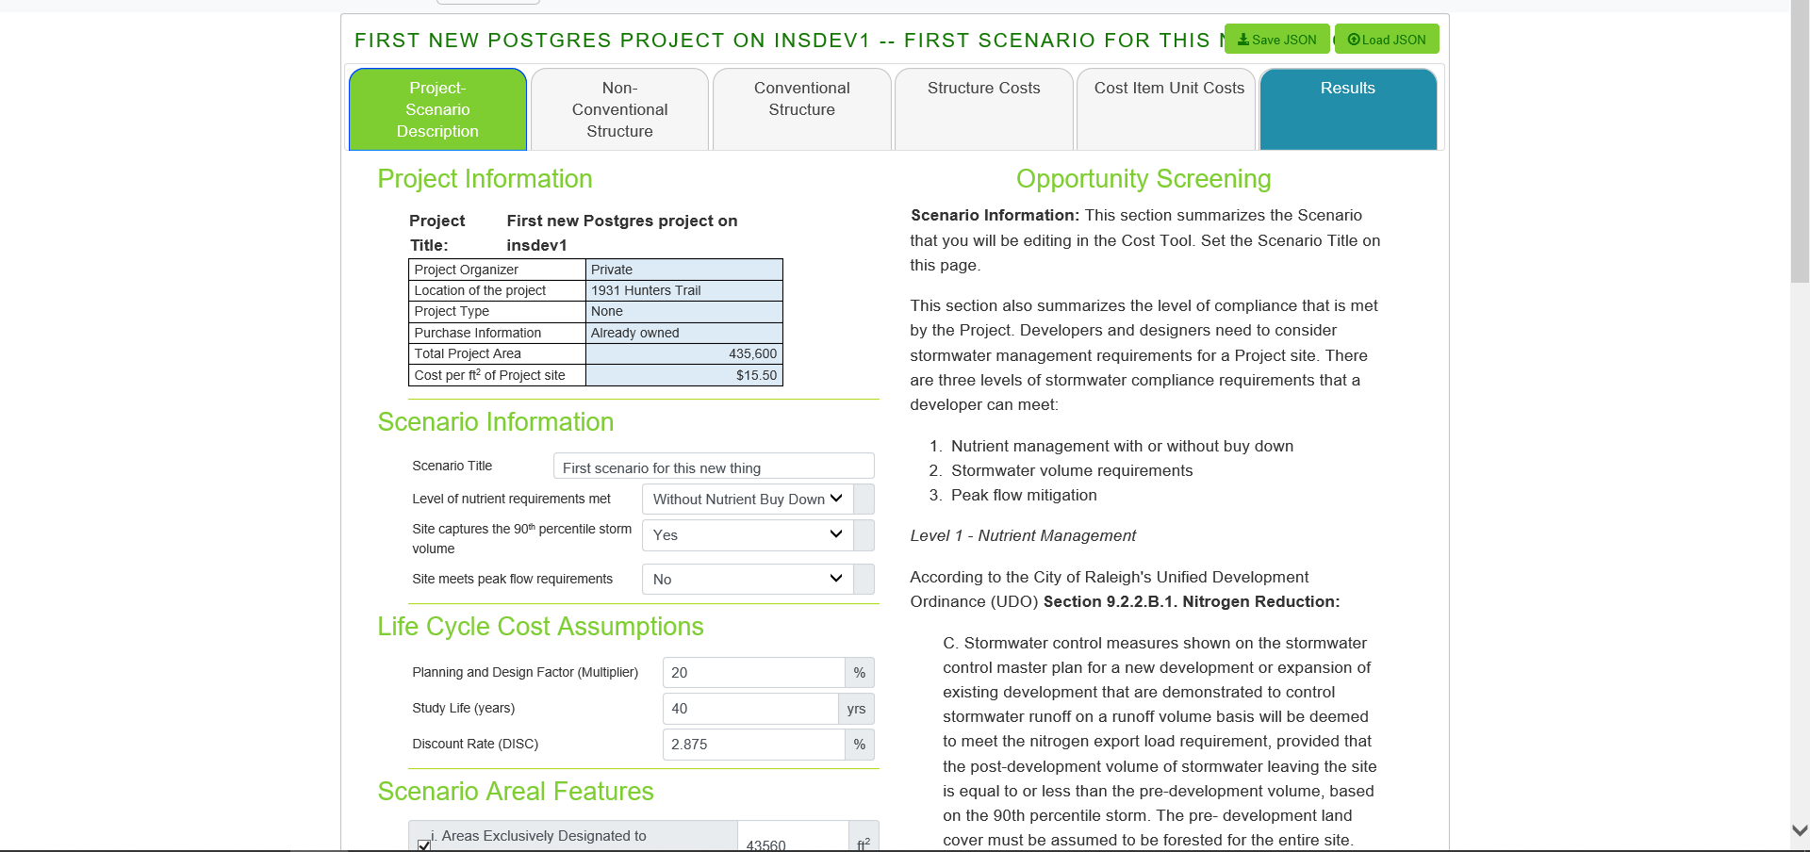
Raleigh
Welcome to the Raleigh GSI Cost Tool
Login
Create New Account
Hot to Set Up the GSI Cost Tool
Why is Raleigh investing in GSI
Instructions

